Slide 1
Plan your trip to Singapore -- Nature lover tourist
Caroline Wang
May 2020

Slide 2
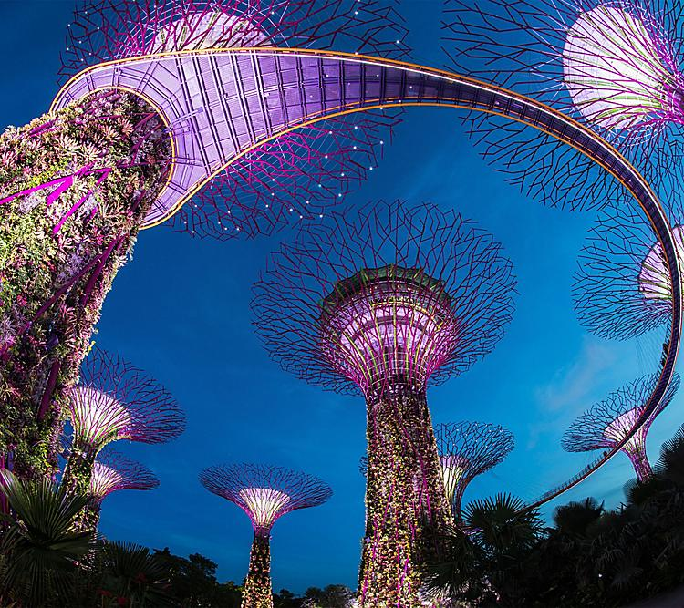
plan to visit Singapore's famous natural parks
“Garden City” in South East Asia, Singapore is packed with natural parks. Properly plan ahead of the travel would save tourist a lot of time and cost.
Can we provide a list of the good reviewed natural parks in Singapore and their neighborhood information, to help the tourists to plan their trip in terms of the venue of hotel, restaurants for food and drinks, etc.?

Slide 3
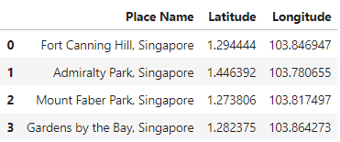
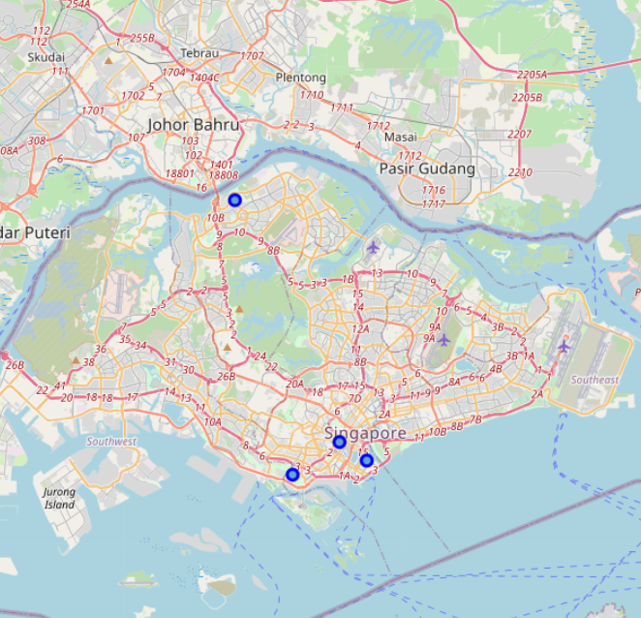
Famous Parks in Singapore

Slide 4
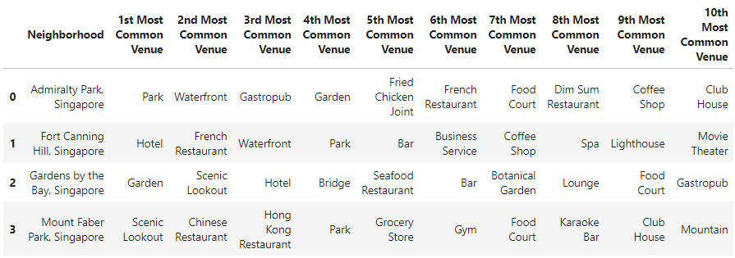
Explore Parks’ Neighborhood
Foursquare API stored types of venues in 500 meter radius of the parks ordered by their frequency

Slide 5
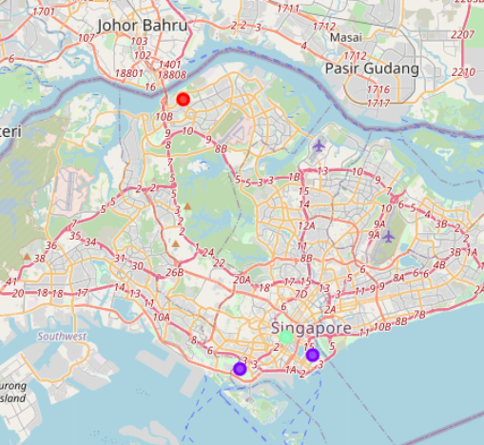
K-means cluster of the parks
Cluster 0: “Wild Nature” – As shown by both the map and the Foursquare AI, park in cluster 0 is joint with other parks, waterfronts. It is in the far north of Singapore, away from the bustle of the city. Together with the joined parks, it reserves the wild nature view of Tropical Rainforest.
Cluster 1: “Scenic Lookout”. The parks in this cluster are surrounded by a lot of scenic lookout, hotels and restaurants. They are the famous place for visit.
Cluster 2: “CBD”. The park in this cluster is near to the business center. It is the best example of “Garden City” of Singapore.

Slide 6
Tips for planning the trip
1. choose hotels near the parks in cluster 1 for the following reasons:
More choice of hotels
Live in a place near nature parks is the best choice for nature lover, they can experience the parks early in the morning and late in sun set.
There are restaurants and grocery stores nearby which is convenient for visitors.
Other scenic lookouts are within the working distance, save time and cost for visitors.
2. visit Fort Cannon Hill near the CBD area to see how people enjoy peacefulness in the bustle of the city in the “Garden City of Singapore”. This park is not far from the parks in cluster 1, one can plan a half day trip here.
3. plan a whole day to visit Admiralty park in cluster 0. It is very different from the other parks. Hope it will be a non-forgetful experience.

